Slide 1
Introduction to Docker
AppDev SIG April 2016
Matthew Favetti

Slide 2
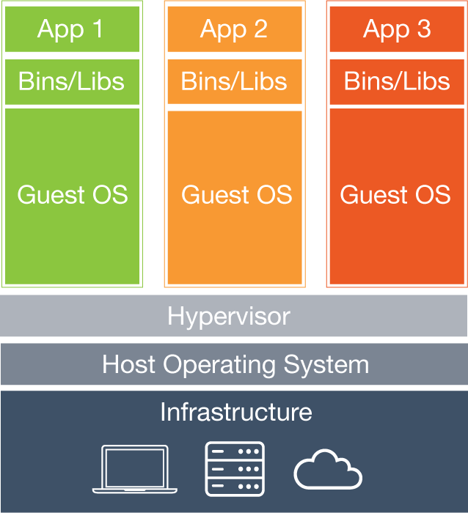
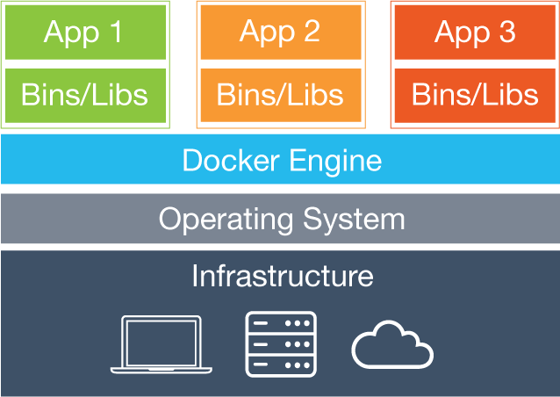
What is Docker?
Packages an application into a container
Containers share the host OS kernel
Not a Virtual Machine (each VM has a separate OS)
Notes:
Including all dependencies (even ones that you didn’t realize you had)
Docker engine is the analog to a VM’s hypervisor (virtualbox)
Don’t use Docker like a VM (tell about how I started with Docker)
Not a replacement for vagrant (vagrant manages VMs)

Slide 3
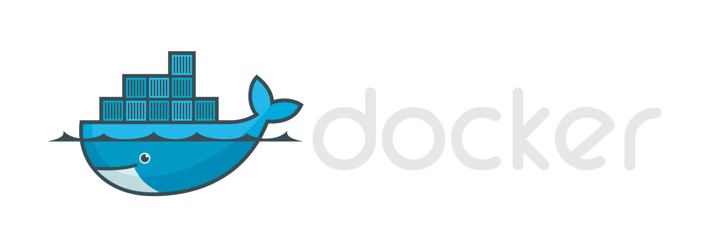
Why Use Docker?
Performance
Optimization (Infrastructure)
Encapsulation (CI/CD, DevOps)
Portability (Cloud)
Notes:
Because there isn’t the overhead of having a Guest OS, containers can be created and started very quickly
The docker engine can better manage the system resources across the containers (RAM, disk space)
Less overhead means you can run more containers on the same box
Your container includes all the libraries, dependencies, and configuration that your app needs to run without changing the host OS environment
Run your container anywhere that docker runs
Portability to the cloud and across infrastructures

Slide 4
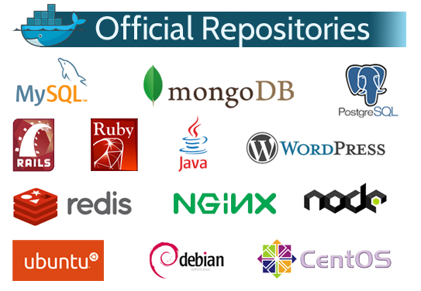
Docker Hub
Docker’s analog of GitHub for images instead of code
Find images (ubuntu, redis, mysql, mongo, node, postgres, etc)
Push / Pull your own images (public)
>1 private image is paid
Also, Docker Trusted Registry is available if you must maintain control over your own code.
Notes:
Some of the most pulled images
Trusted registry is part of paid docker datacenter paid platform

Slide 5
Getting Started
Build/push/pull images
Run an image to create a container
The container runs a command and stops when it exits
You can start/stop/restart, attach to the console, view logs, inspect configuration, etc
Make changes in the container, commit the changes back to an image
Tag images for easy reference

Slide 6
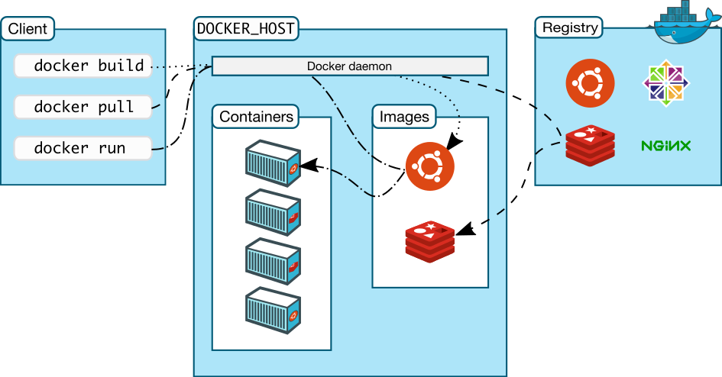
Process Overview

Slide 7
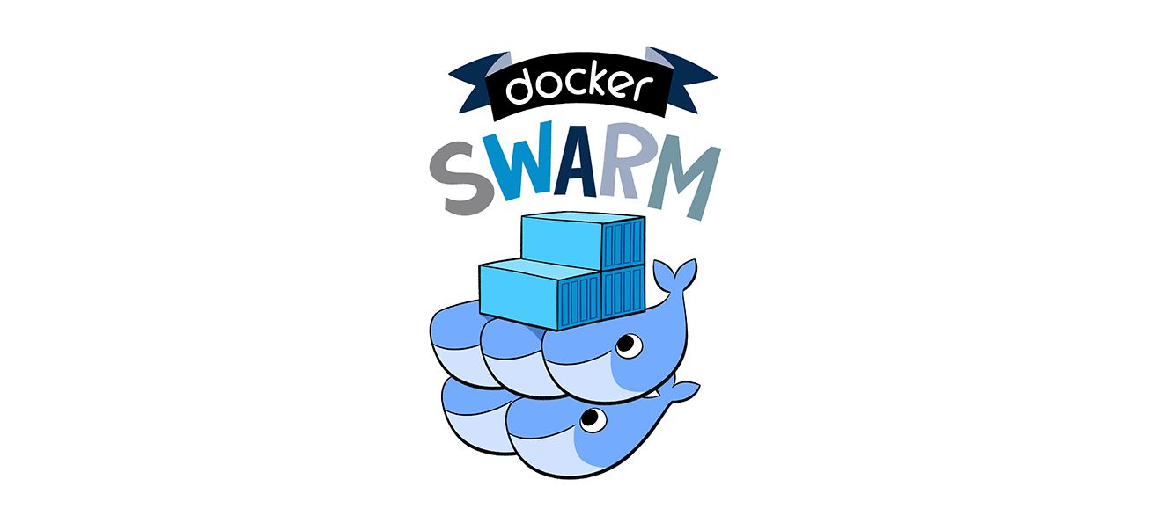
Beyond the Basics
Run multiple commands utilizing supervisor (or similar)
Networking (map host ports to the container, etc)
Data Volumes / Data Volume Containers
Persist data
Share data among containers
Docker swarm (native clustering)
Notes:
Role-based containers (not process based or application based)

Slide 8
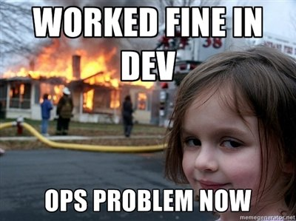
Configuration as Code
Dockerfile
All the steps necessary to build your container
“Document” the exact requirements / environment / dependencies of your app
Docker-compose
Multiple (or single) container apps
Abstract command line arguments
Notes:
Hosts file entry example

Slide 9

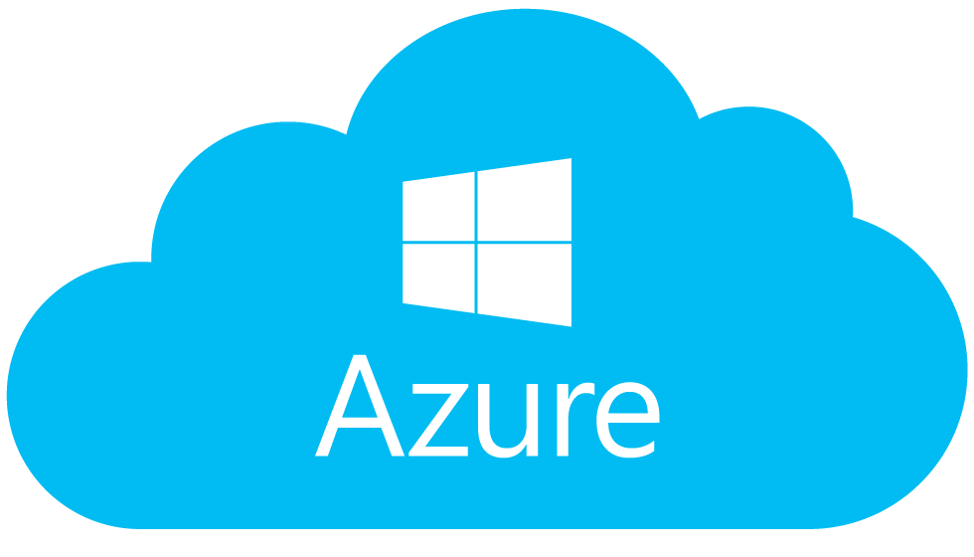
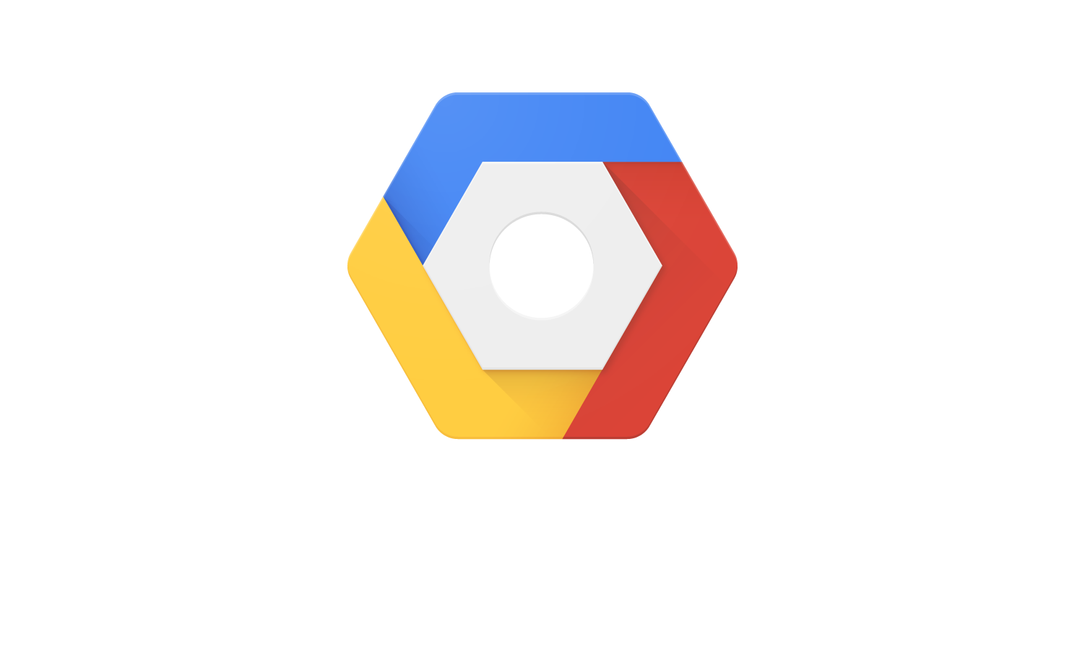
Docker in the Cloud
Provision manually
Install Docker
Pull the image from Docker Hub (or private registry)
Provision using management tools
Docker-machine (this is also used to run docker on Windows/OS X)
Docker Cloud (formerly Tutum)
Universal Control Plane (on premises)
Cloud service specific tools
AWS EC2 Container Service
Azure Container Service
Google Container Service (Kubernetes)
Notes:
Also consider the fees of using the particular cloud service itself
In addition the different platforms’ container tools have various pricing models
UCP is paid from Docker

Slide 10
Quick Demo
Run a Simple node.js webserver in a Docker container
Create the app
Write the Dockerfile
Simply by using the official repositories from Docker Hub
Write a docker-compose file
Add a database

